Slide 1
Star Wars Genetic Analysis
Keith Condray-Raderstorf, Srikar Namburi, Heinrich Martens

Slide 2
Structure Analysis

Slide 3
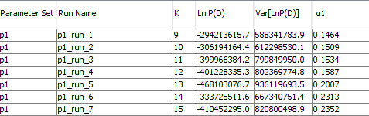
Structure Data and Migration Rates
K=13 has the highest negative Ln P(D), indicating this is the most likely K
The actual K is 12, which has the 3rd highest Ln P(D)
K=15 has the second highest Ln P(D), but there is a much smaller gap between the Ln P(D) of 12 and 15 than 13 and 15

Slide 4
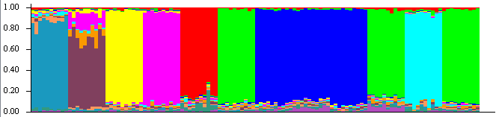
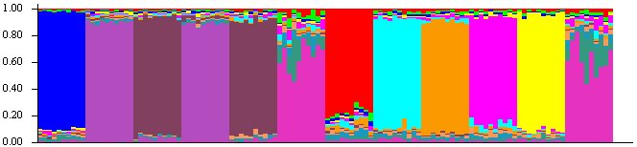
Inconsistencies Between K=12 and K=13
For K=12, 2 groups (each consisting of three populations) seem to have high migration rates, Populations 6, 10 and 12 and Populations 7, 8, and 9
For K=13, 3 groups (each consisting of 2 populations) seems to have high migration rates, Populations 2 and 4, Populations 3 and 5, and Populations 6 and 12
K=12
K=13
Based on these two different K’s, the only solid conclusion is that Populations 6 and 12 definitely share high migration rates.

Slide 5
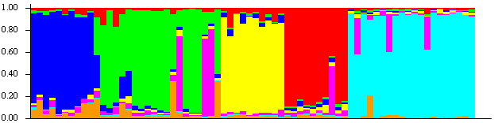
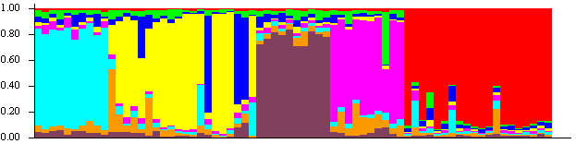
Looking at different K’s for other data
It is unclear why we would get results of high migration between different populations depending on K, especially when K is so close. Looking at the structure results of different data with different K’s, we don’t see this trend
K=7
K=8
In both of these graphs for the different K’s, we can clearly see that there are high migration rates between Populations 2 and 3 and Populations 6 and 7. There is no difference in which populations the graphs indicate have high migration rates

Slide 6
Interesting Pi Plots

Slide 7
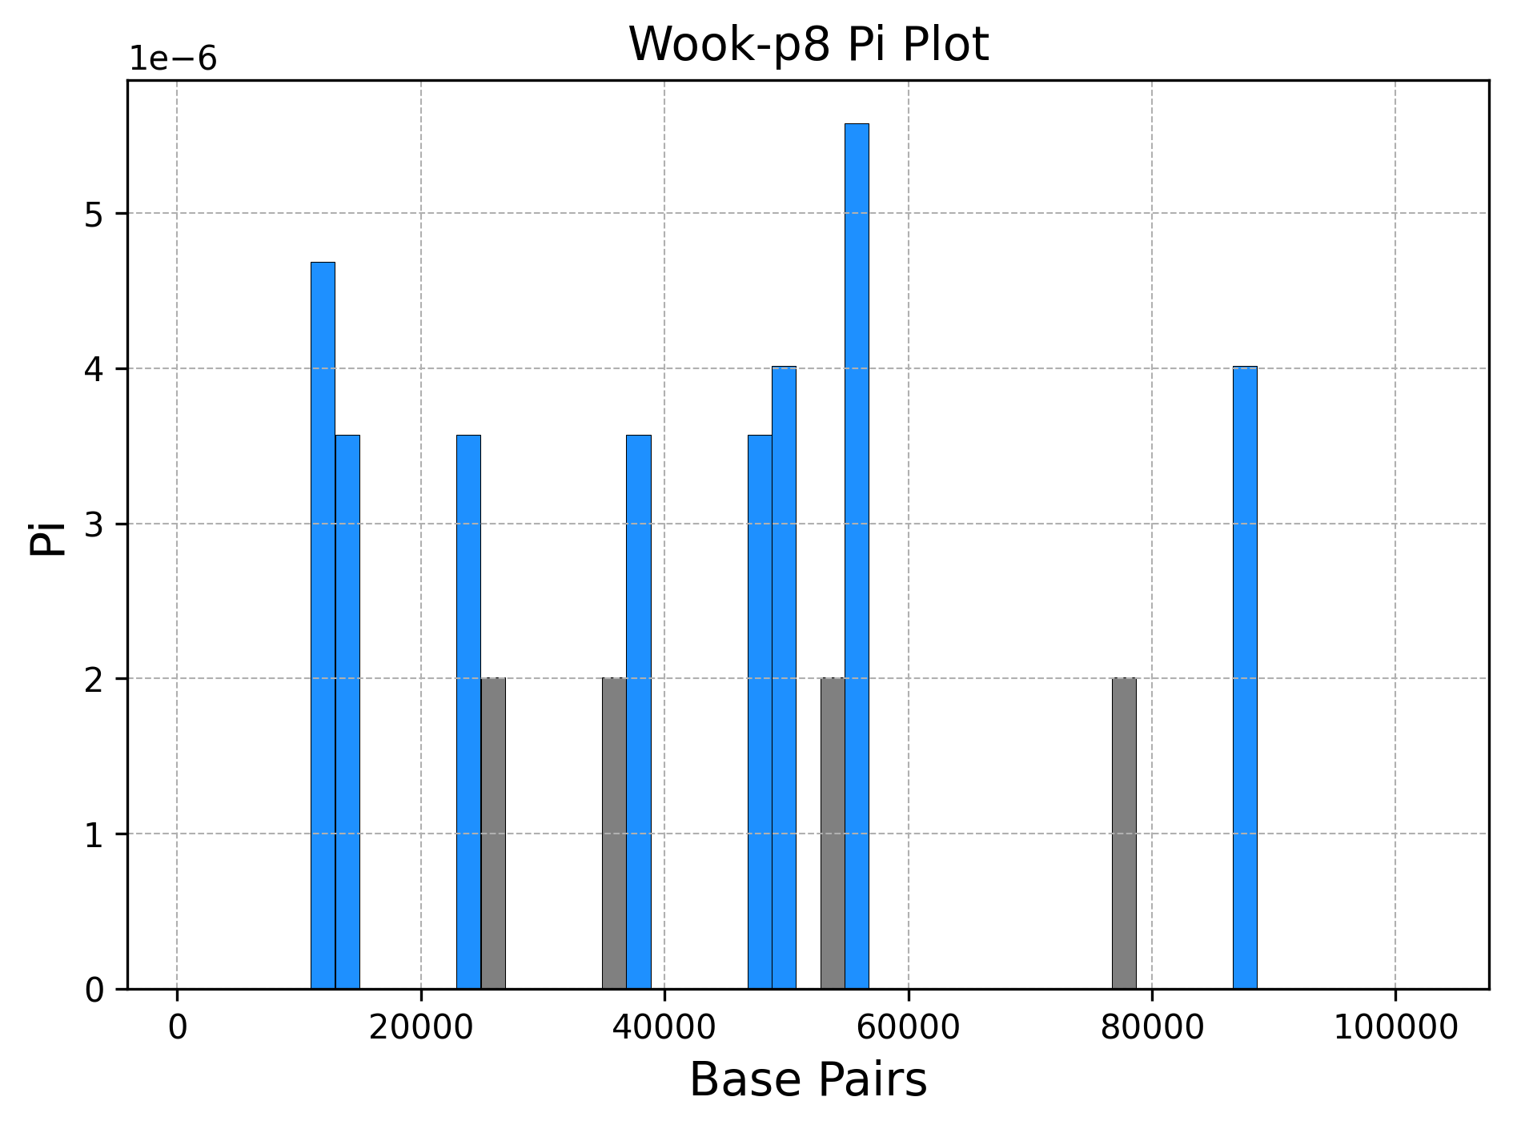
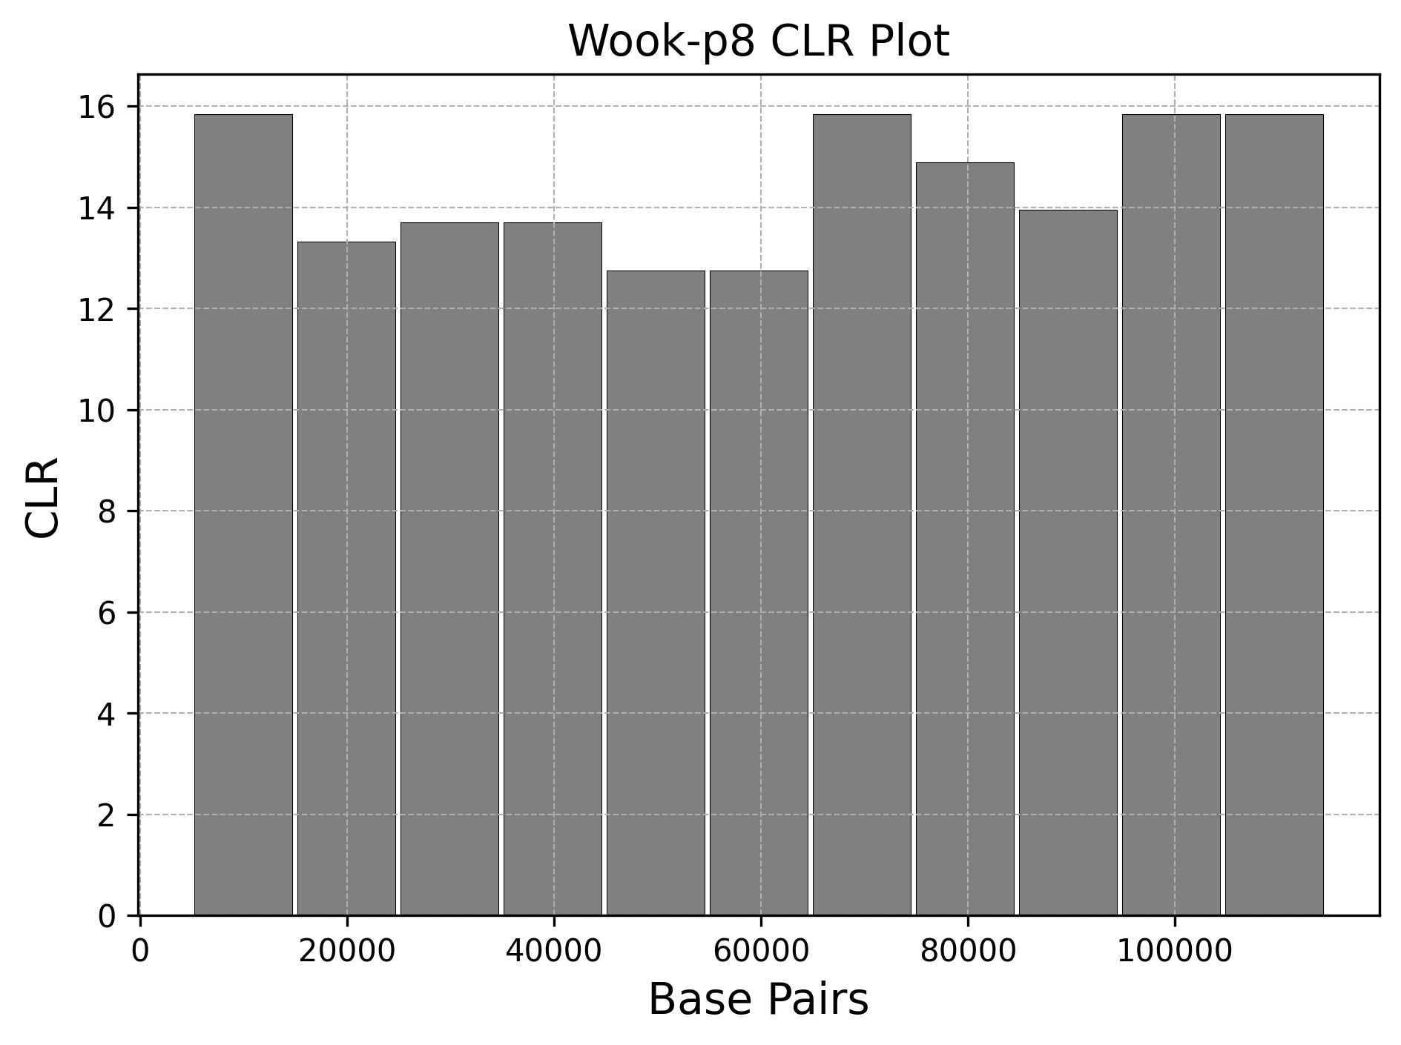
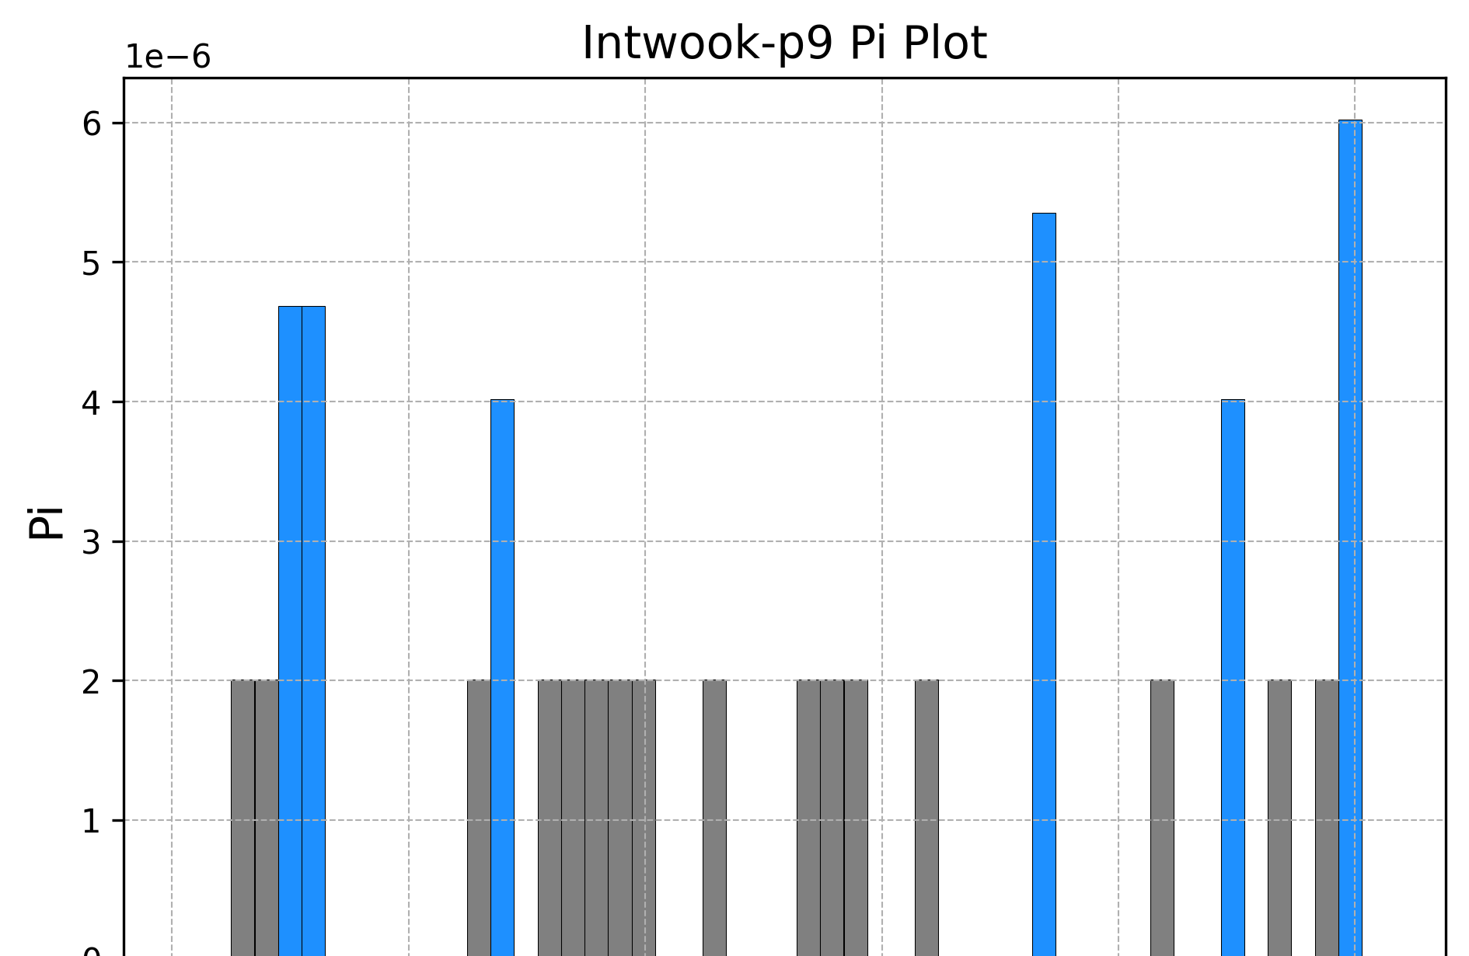
Notes:
Compared to the rest of the populations, the wookie population has the smallest number of bars and overall has the lowest Pi(Pi lower by a factor of 10). (Pi value of 4.06e-05) A lot of different theories could be arised, but the most likely would be that a recent sweep has occurred . The other theory was that it was due to the Wookies being a new population, but with a lot of blue bars compared to grey bars this isn’t what a new population would have. Also the CLR graph, supported our results since there are no significant bars and that the CLR also decreases between 20000 and 40000 bp.

Slide 8
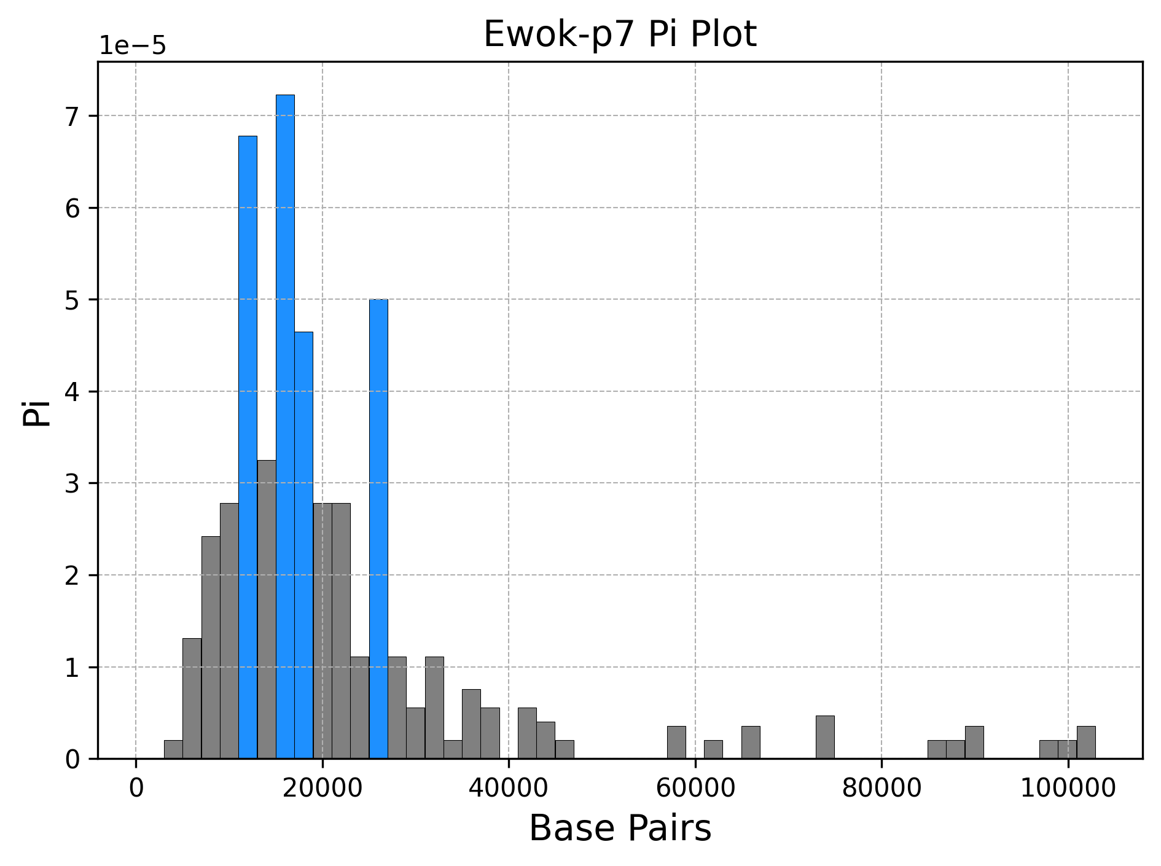
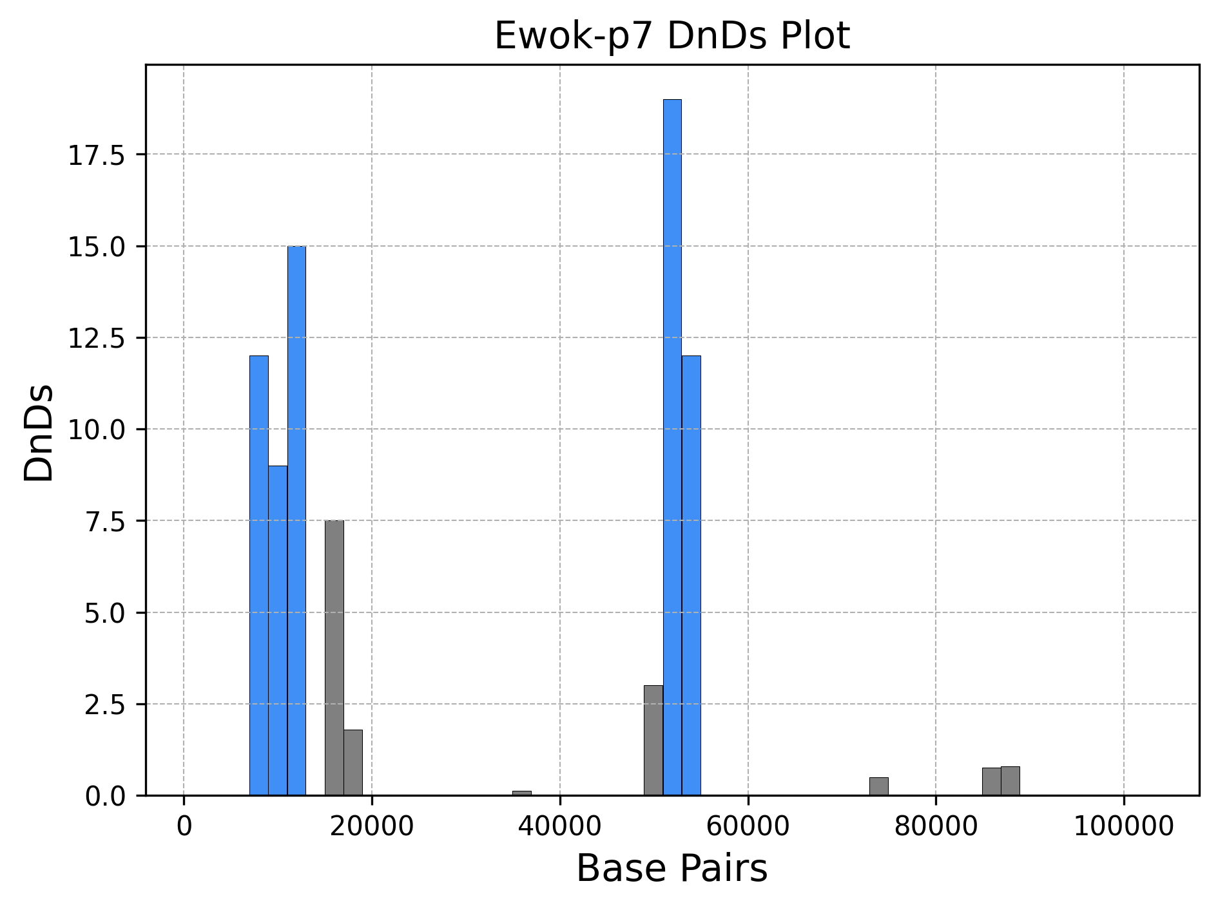
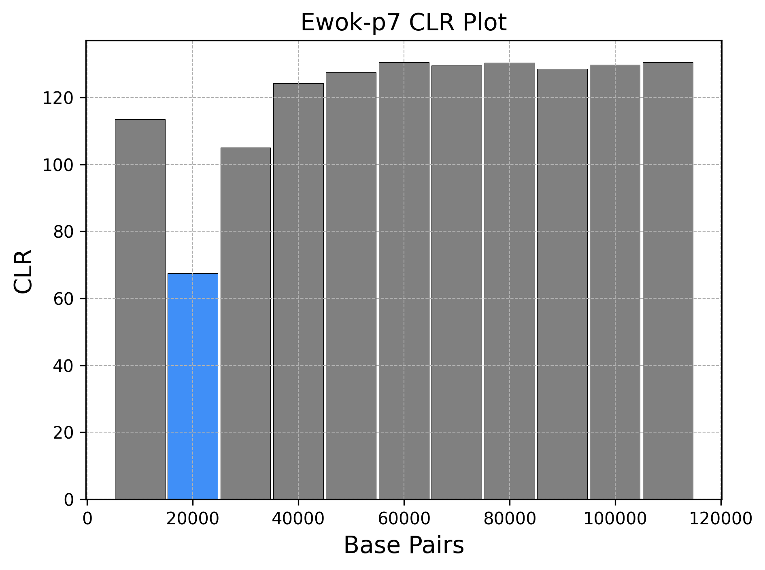
Notes:
Ewoks, Subhumans, and Twilikes have a kind of cluster of significant bars and grey bars towards the lower base pairs. But as you go through more and more base pairs, the value of the grey bars decreases largely. A reason for this again, is a sweep that changes genes to be synonymous with the exception of a gene between 500 and 40,000 bp. The subhuman population and twilikes are representative of this data as well. So a possibility could be that these three populations share a gene and may potentially be related to each other.

Slide 9
Similarities between Populations

Slide 10
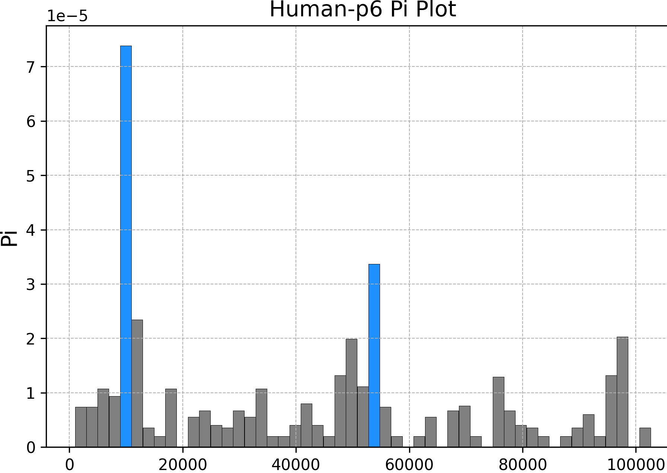
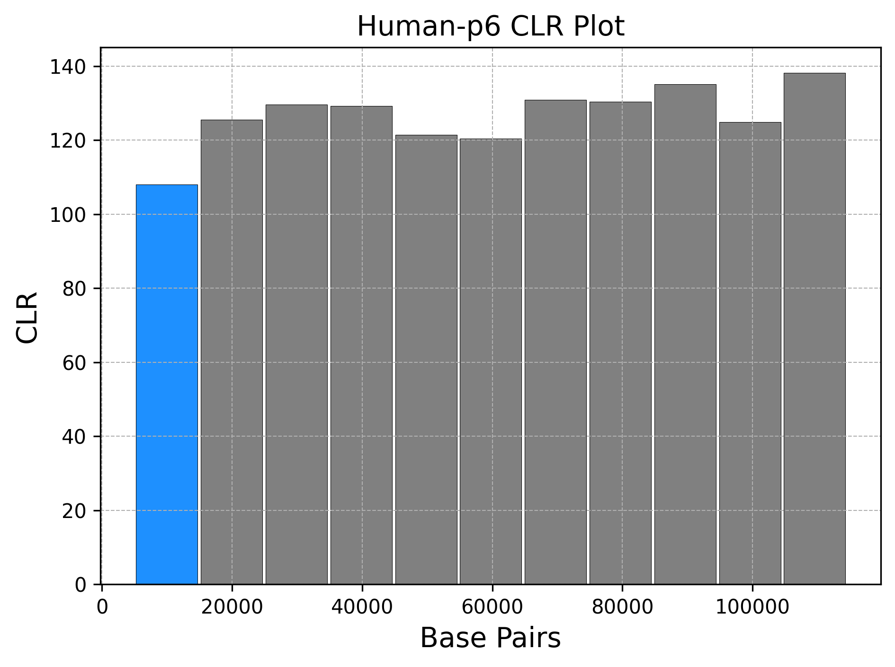
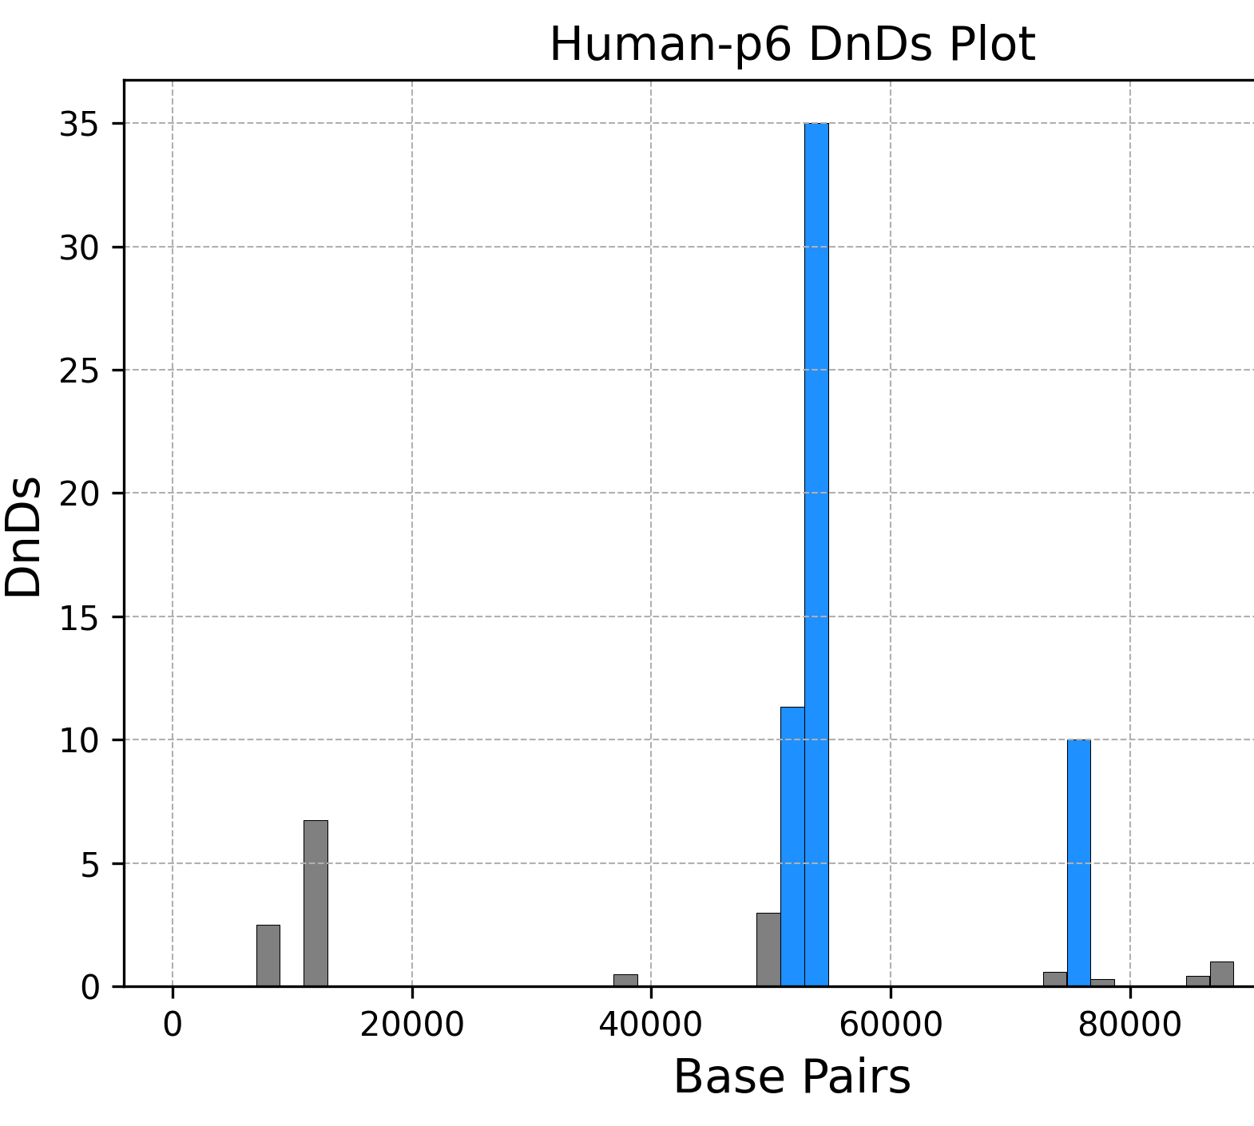
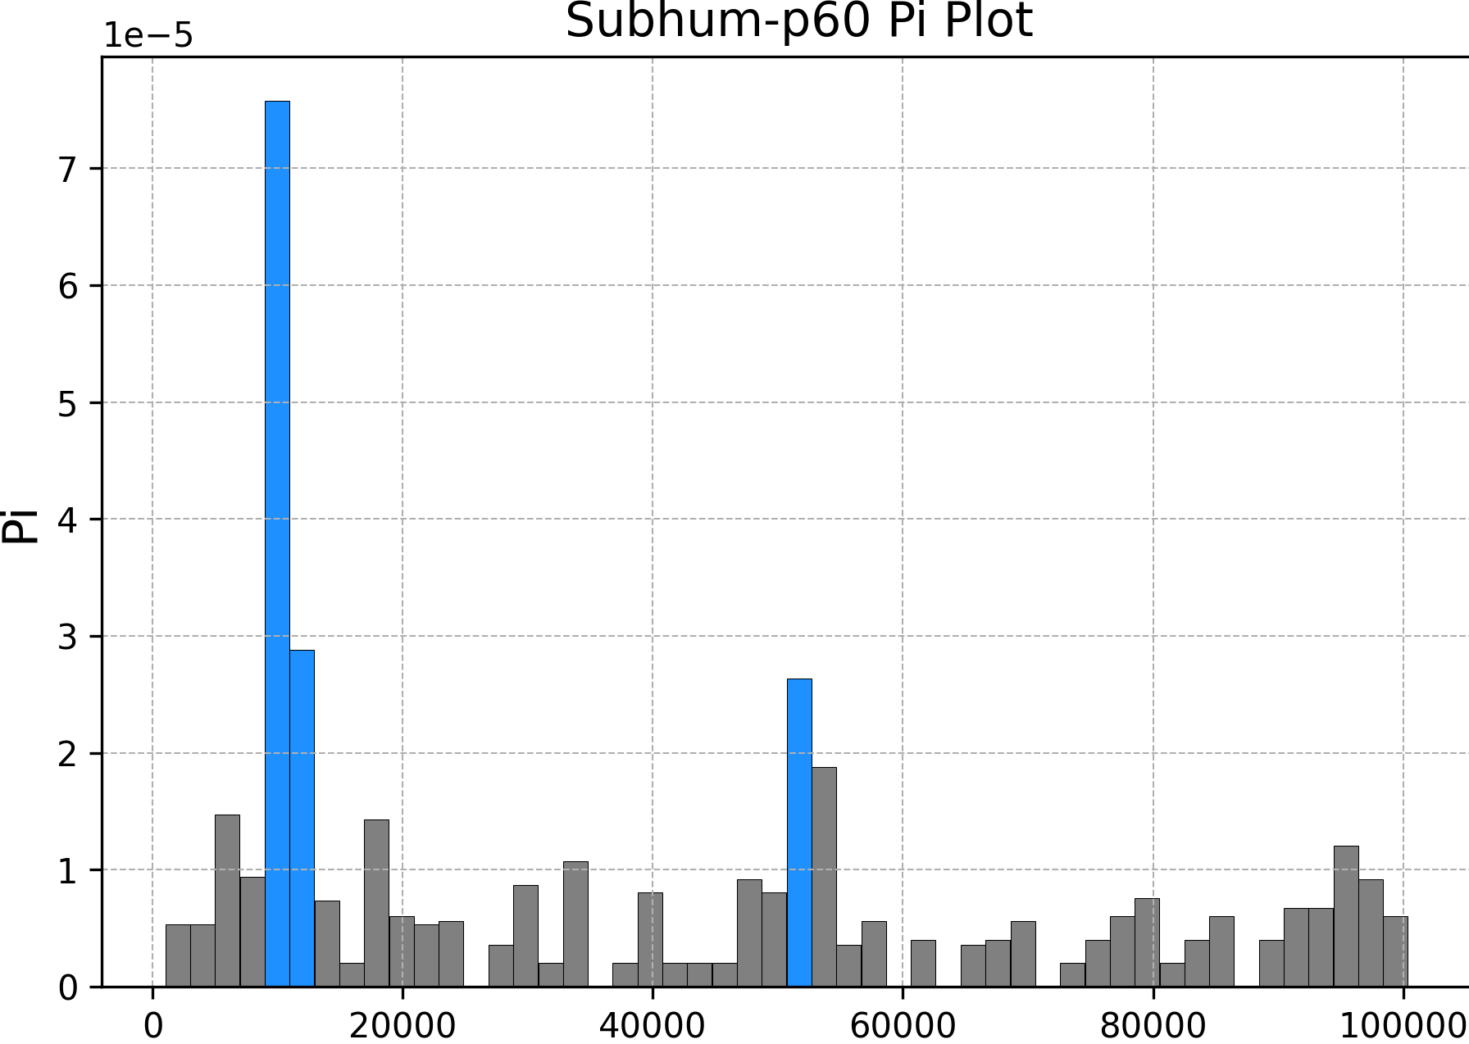
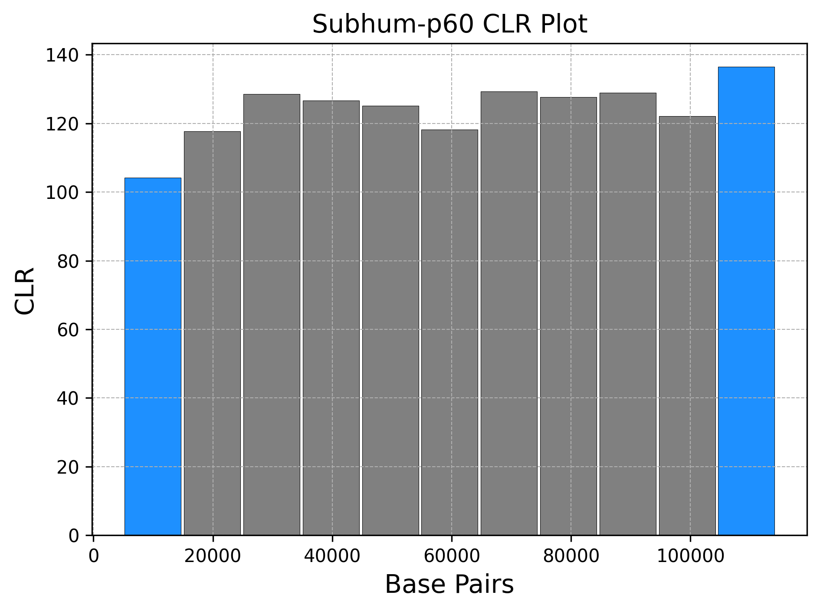
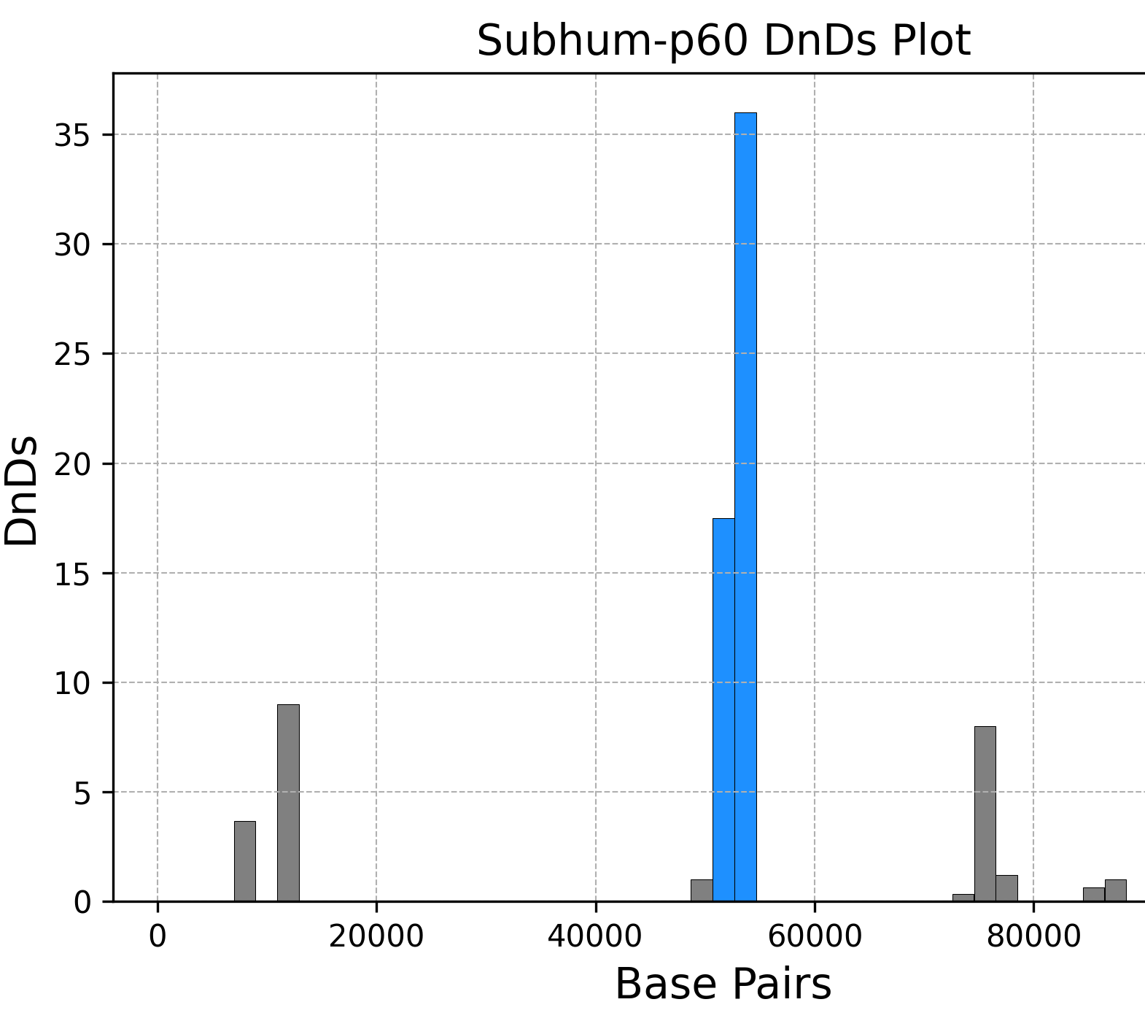
Notes:
Basically the same graph so must be a very recent split.. Probably the blue chunk in the Structure plot

Slide 11
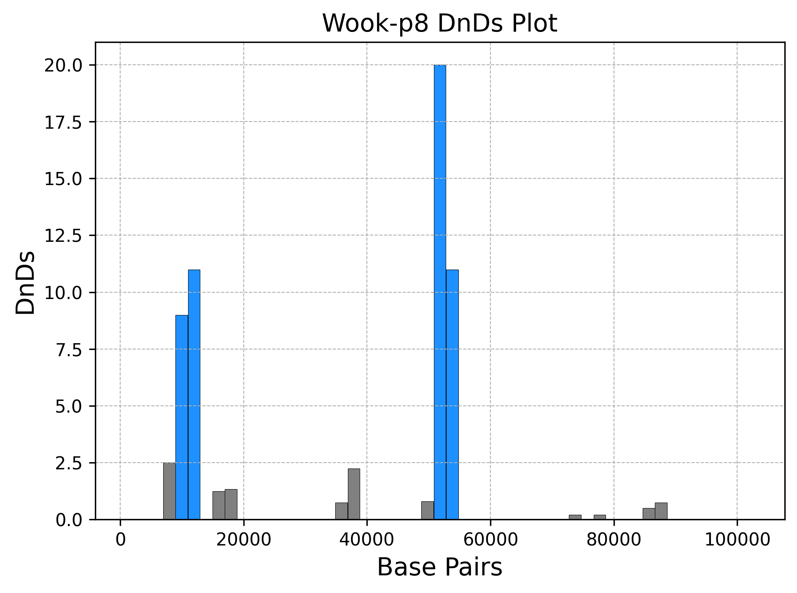
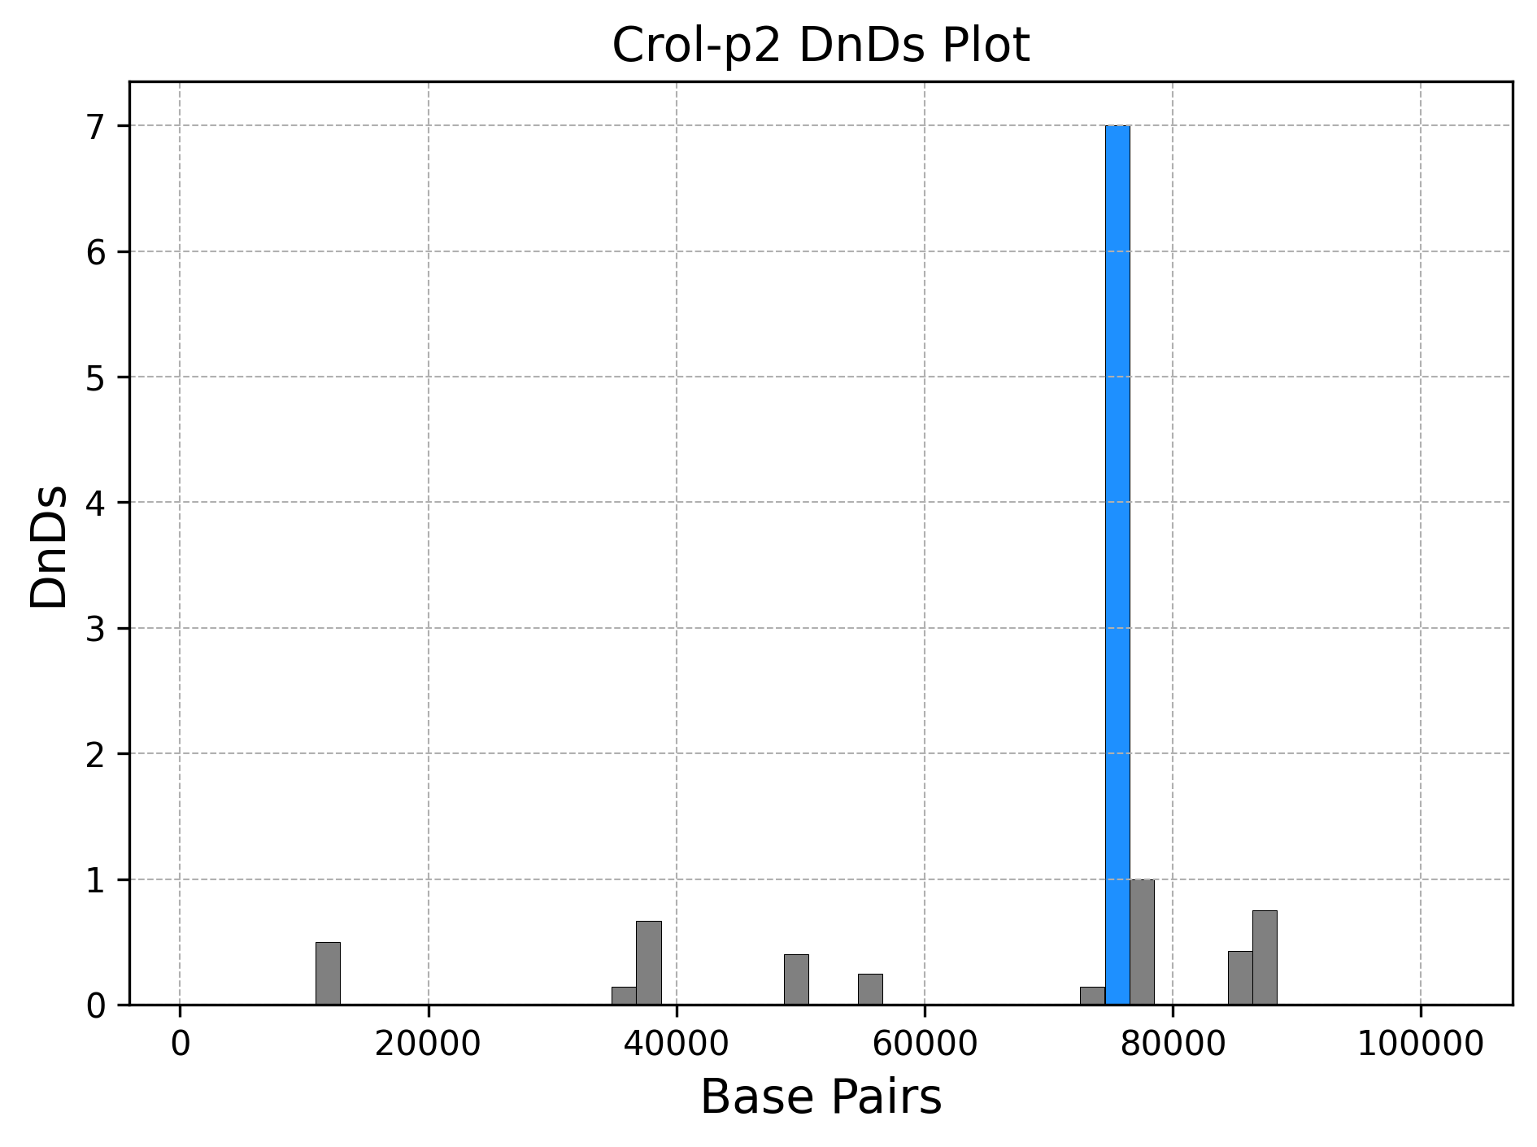
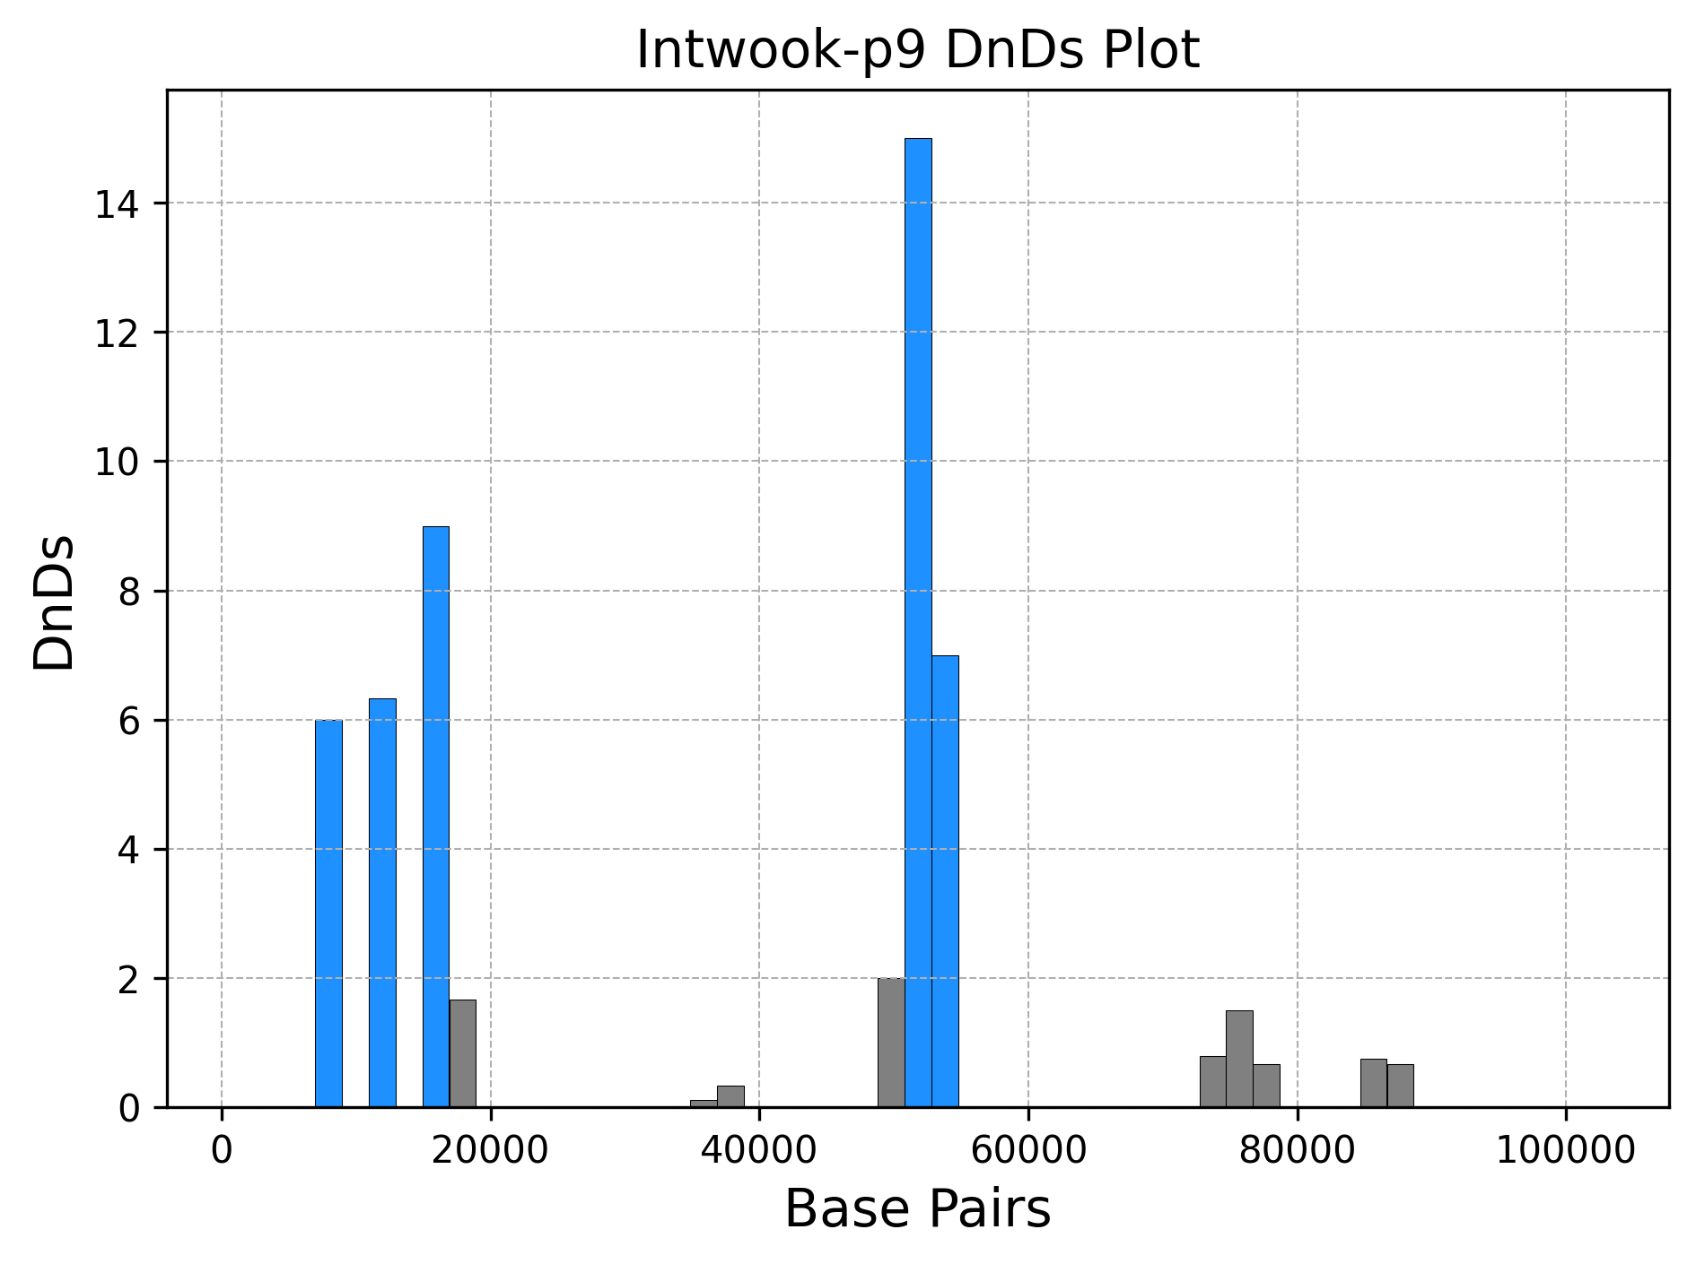
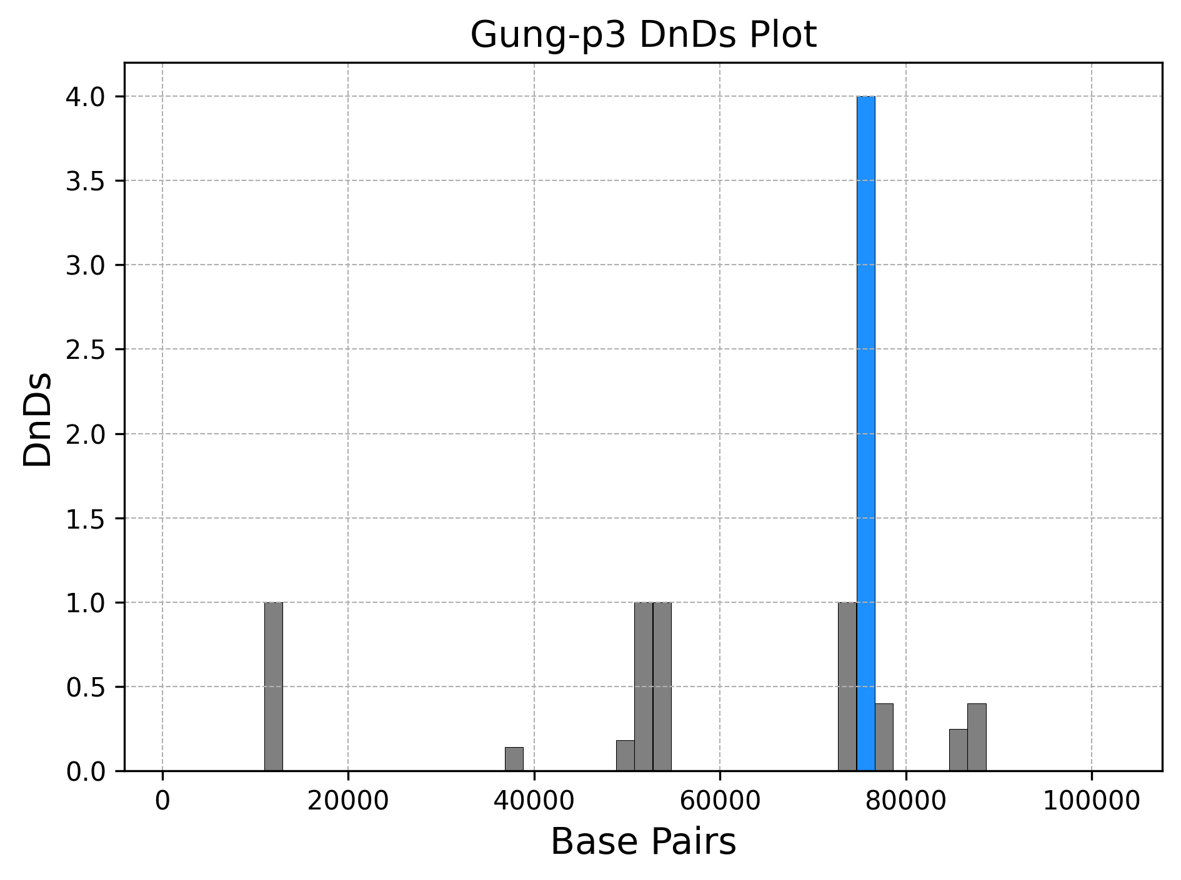
More highly similar populations
P2 & P3 as well as P8 & P9 of the data set also shared lots of similarities.
This was to a lower extent than the previous example but still strong evidence they share a recent ancestor.

Slide 12
Population Groupings
Group A
Humans
SubHumans
IntHumans
Twi’lek
Ewok
Group B
Crolutes
Gungans
Mon Calamari
Abednedo
Group C
Wookies
IntWookie

Slide 13
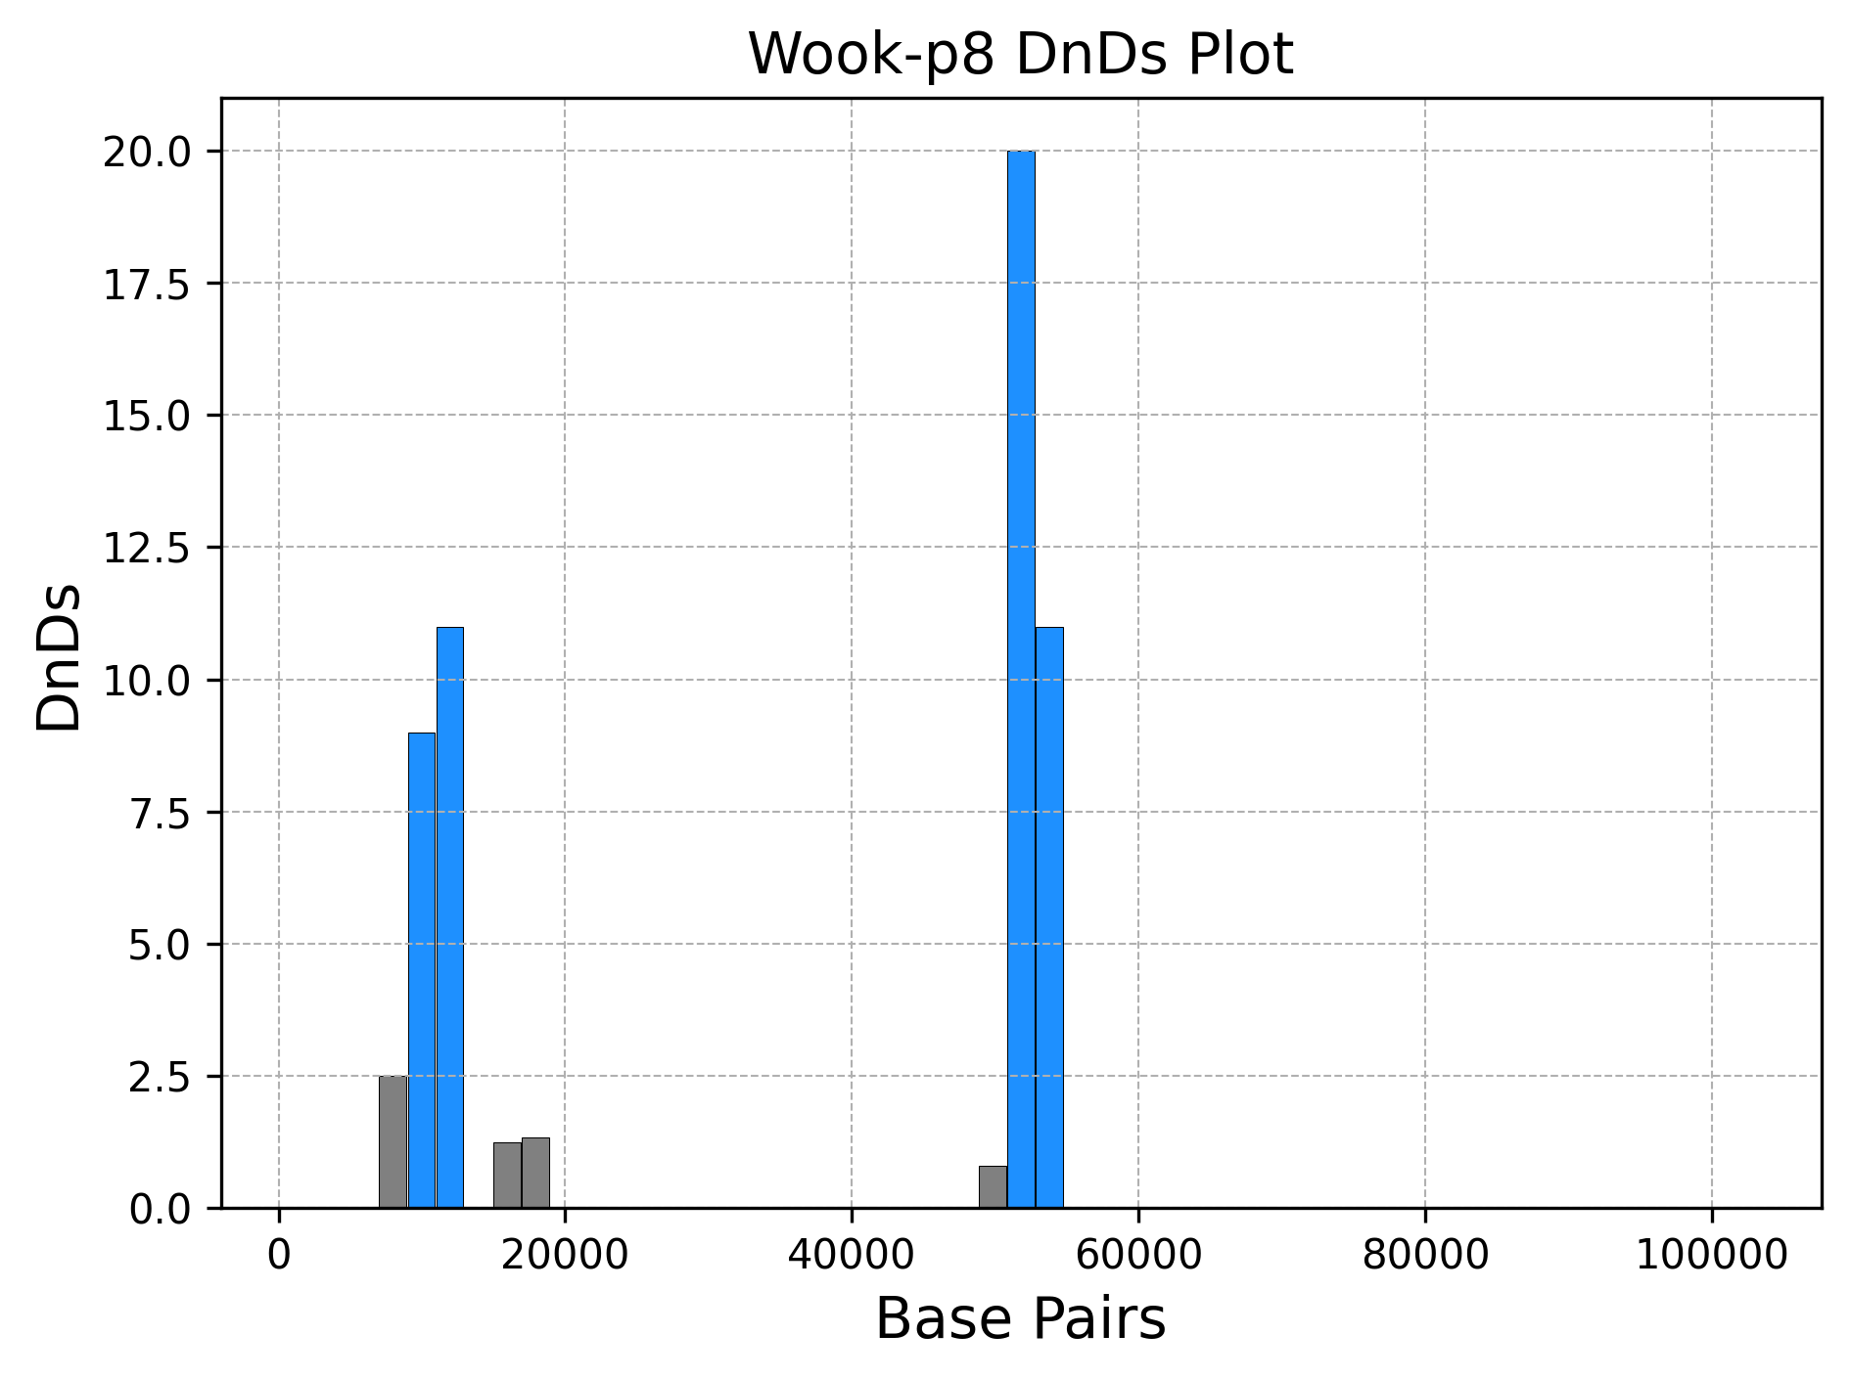
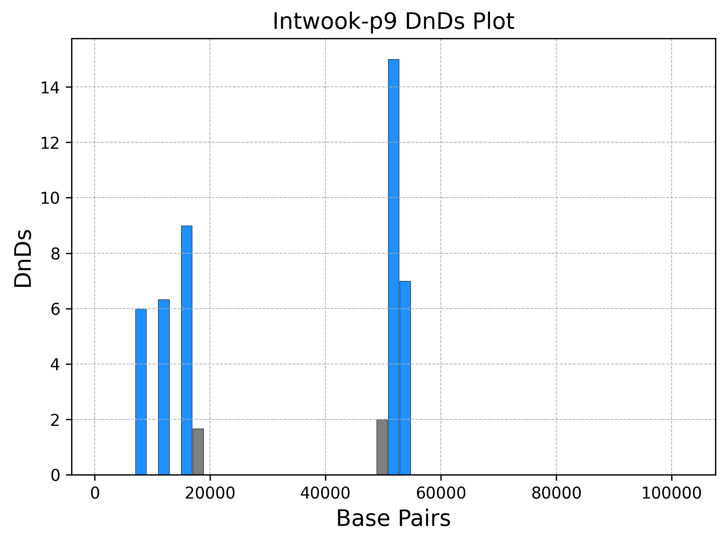
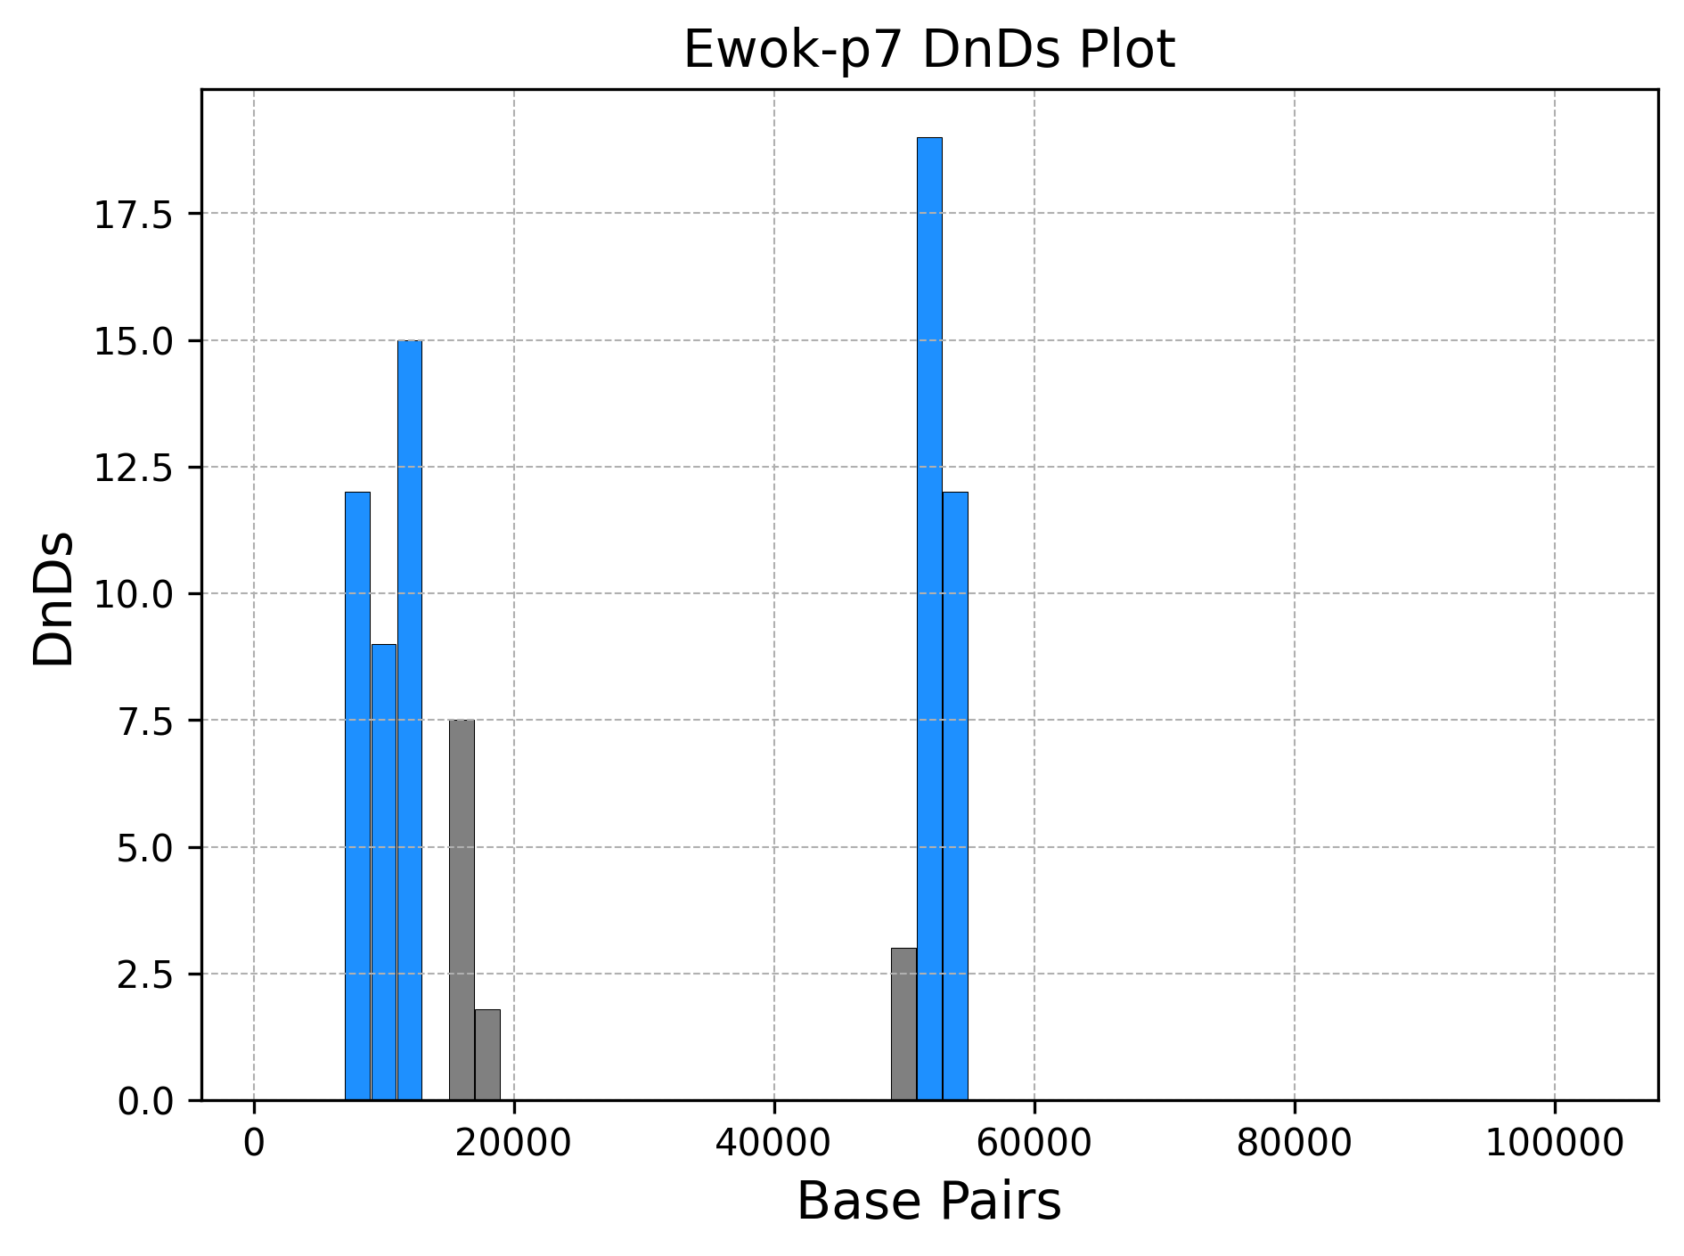
Connections between Groups A and C
In the Dn/Ds plots it is fairly clear that these populations are similar.
Group C
Group A
Notes:
The similar spikes probably indicate that these three populations all all shared a common ancestor at some point as it is unlikely that they independently developed these non-synonymous mutation at the same spot on their own. Due to this we think that the Ewoks which also also share a lot of commonalities with Group A - where they are placed - where the ancestor of all populations that were formed in Group B.
It seems most probable that the Wookies were the direct descendant of the Ewoks as they are the closed match to them. A difference between the Ewoks and the Intwookie population that seems to further separate them is the different mutation group from 10k - 20k bp where they have three spikes with gaps and the wookies and ewok have a more narrow spike that is not seperated by any gaps.

Slide 14
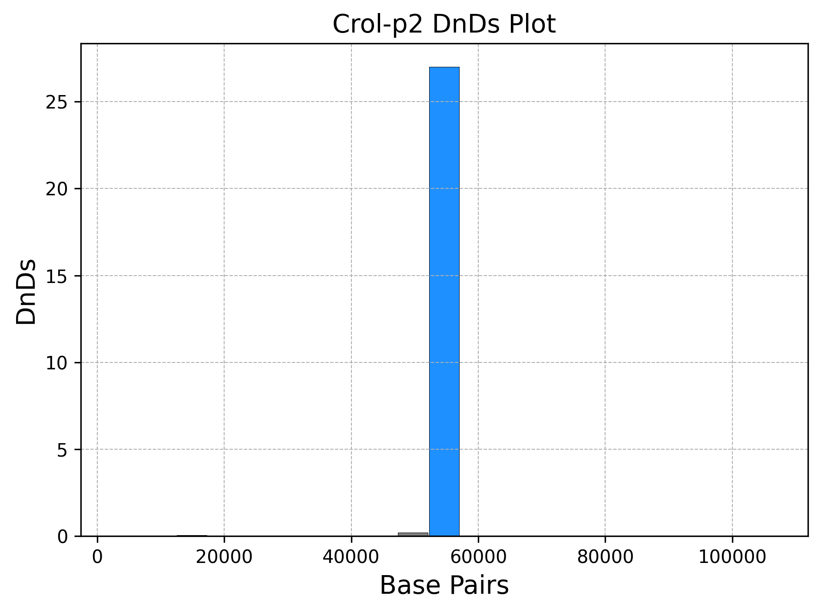
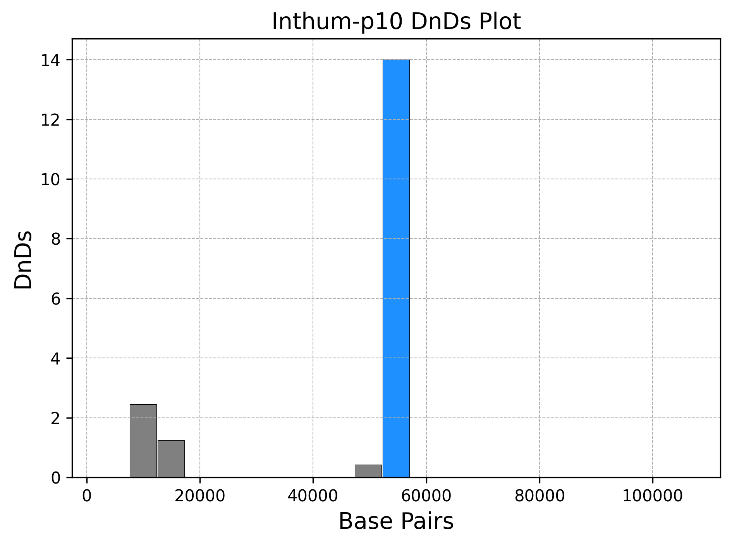
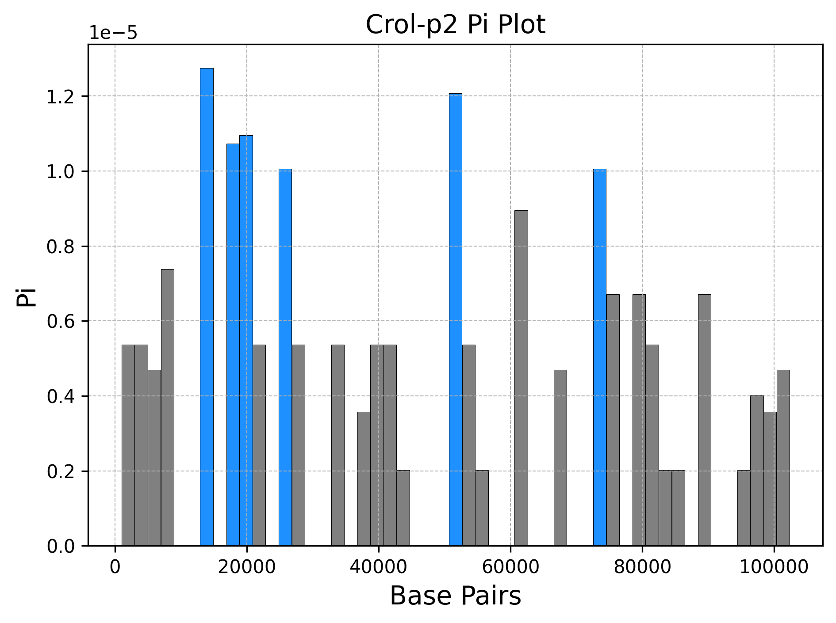
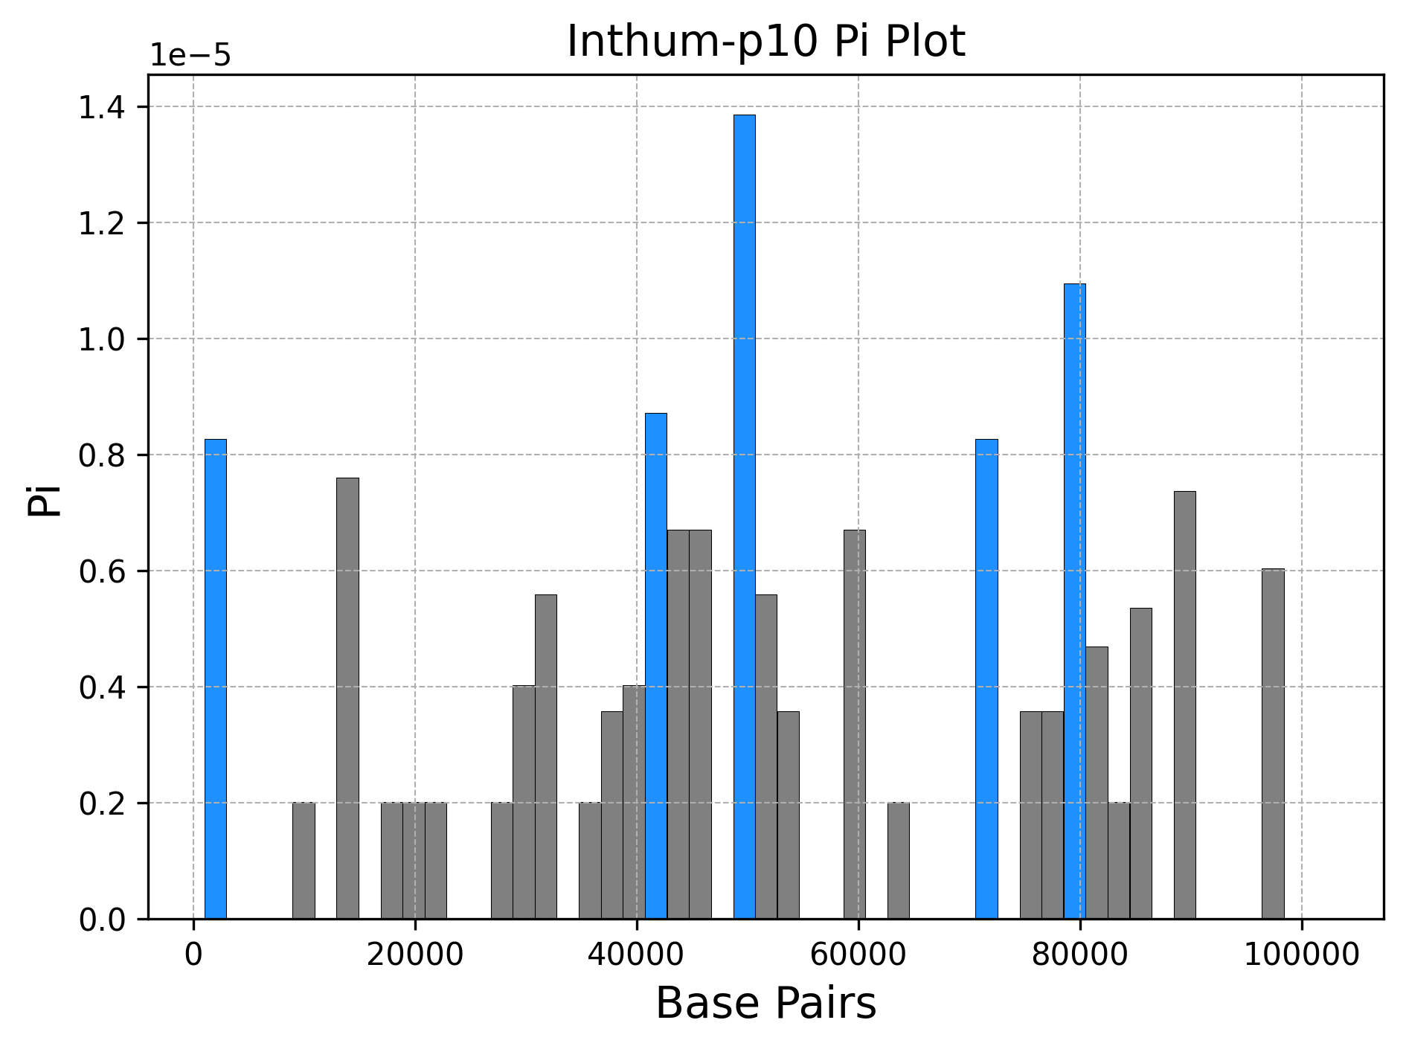
Connection between Group B and C
Notes:
The croi populations are very similar to the inthum population and this can be show through the Pi and DnDs plots. In the Pi Plot, they have a widespread of significant bars and that the Pi ranges are also in the same range. In the Dn/Ds plot, the significant bars are quite few and that the two populations have about the same but the ranges are different from each other. The Dn/Ds plot has the same plot pattern and the ragne is about the same as well. Based on the Pi plot and the Dn/Ds plot, we can assume that these two populations are quite similar and are either descendants from a common ancestor or that one population is a descendant of the other.

Slide 15
Thanks!

